Slide 1
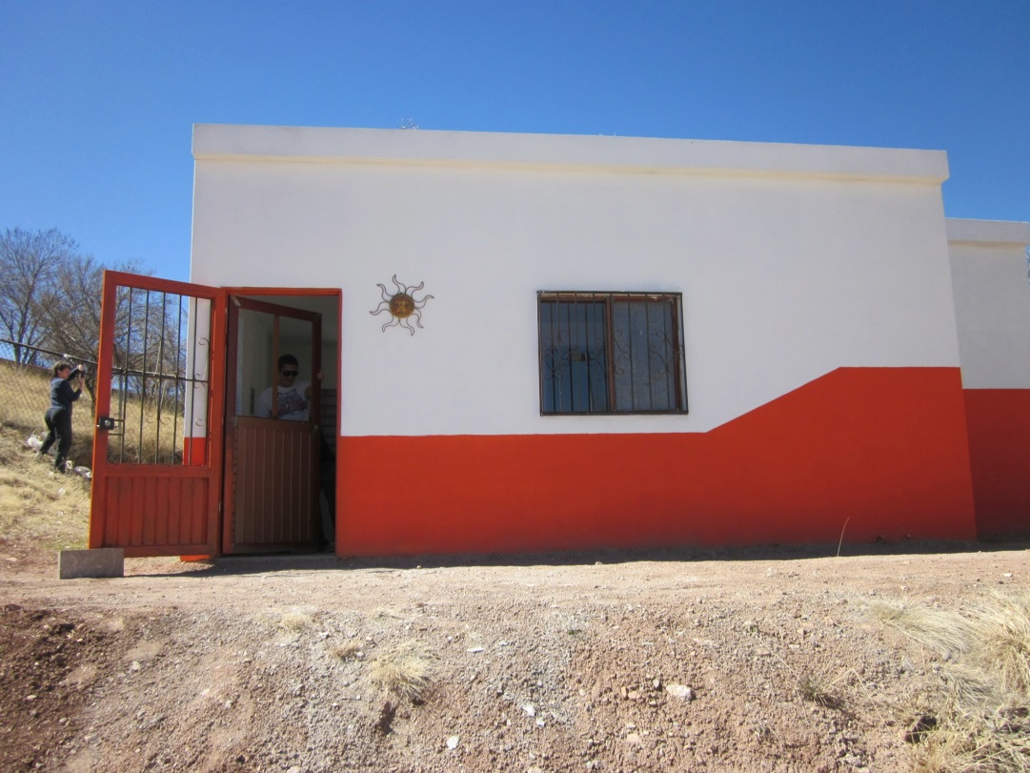
How to build an Eco-Casa
ConFib (Concreto Fibroso or Fibrous Concrete) is the name chosen
by a team of community members, students, and teachers from various schools and neighborhoods on both sides of the border. ConFib consists of small amounts of cement and large amounts of recycled paper that has been used to build benches, walls, and even entire houses. It is non-flammable, an insulator, and cheaper than building with concrete.
Types of paper you can use:
Newspaper works best because it dissolves in water quickly.
Office paper also works fairly well.
Cardboard will take more time and water to soften.
Magazines can be used in combination with other papers, but not alone.
Ratio of ConFib mix:
1 part paper, pulped and dried
1 part Portland cement
¼ part lime
8 parts sand
Water

Slide 2
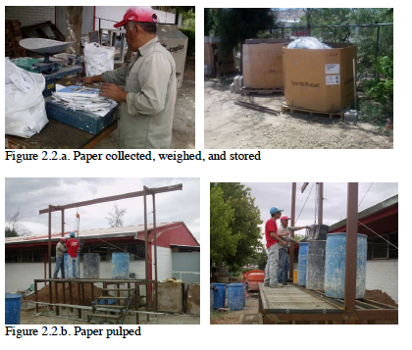

Slide 3
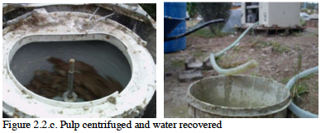

Slide 4
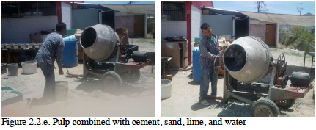
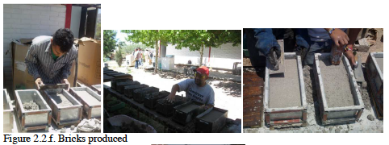

Slide 5
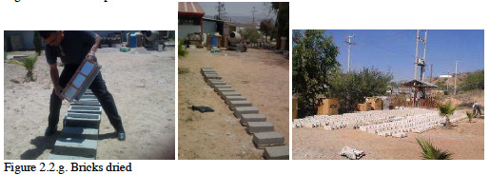
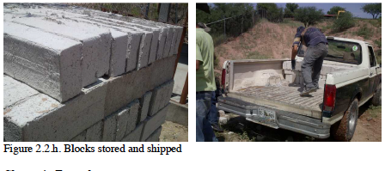

Slide 6
